Slide 1

@PURNADATASCIENCE

Slide 2

Overview
This project involves analyzing healthcare data to provide insights into various aspects of patient care and provider performance. The dataset includes information on patient treatments, healthcare providers, and insurance coverage, with a focus on evaluating treatment costs, insurance coverage, and follow-up requirements.

Slide 3

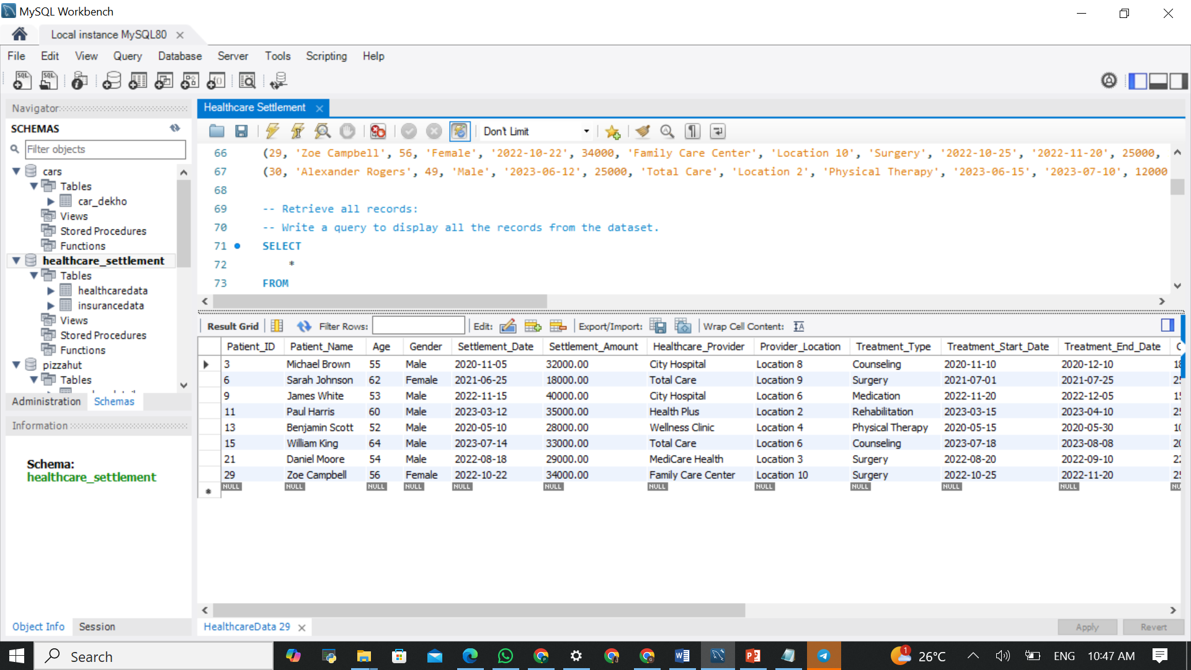
List all treatments involving surgery:
SELECT * FROM HealthcareData WHERE Age > 50;

Slide 4
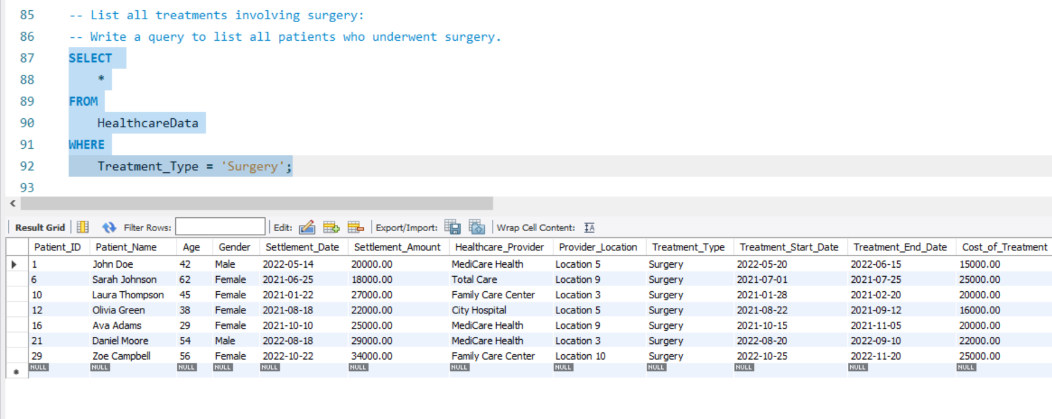
List all treatments involving surgery:

Slide 5
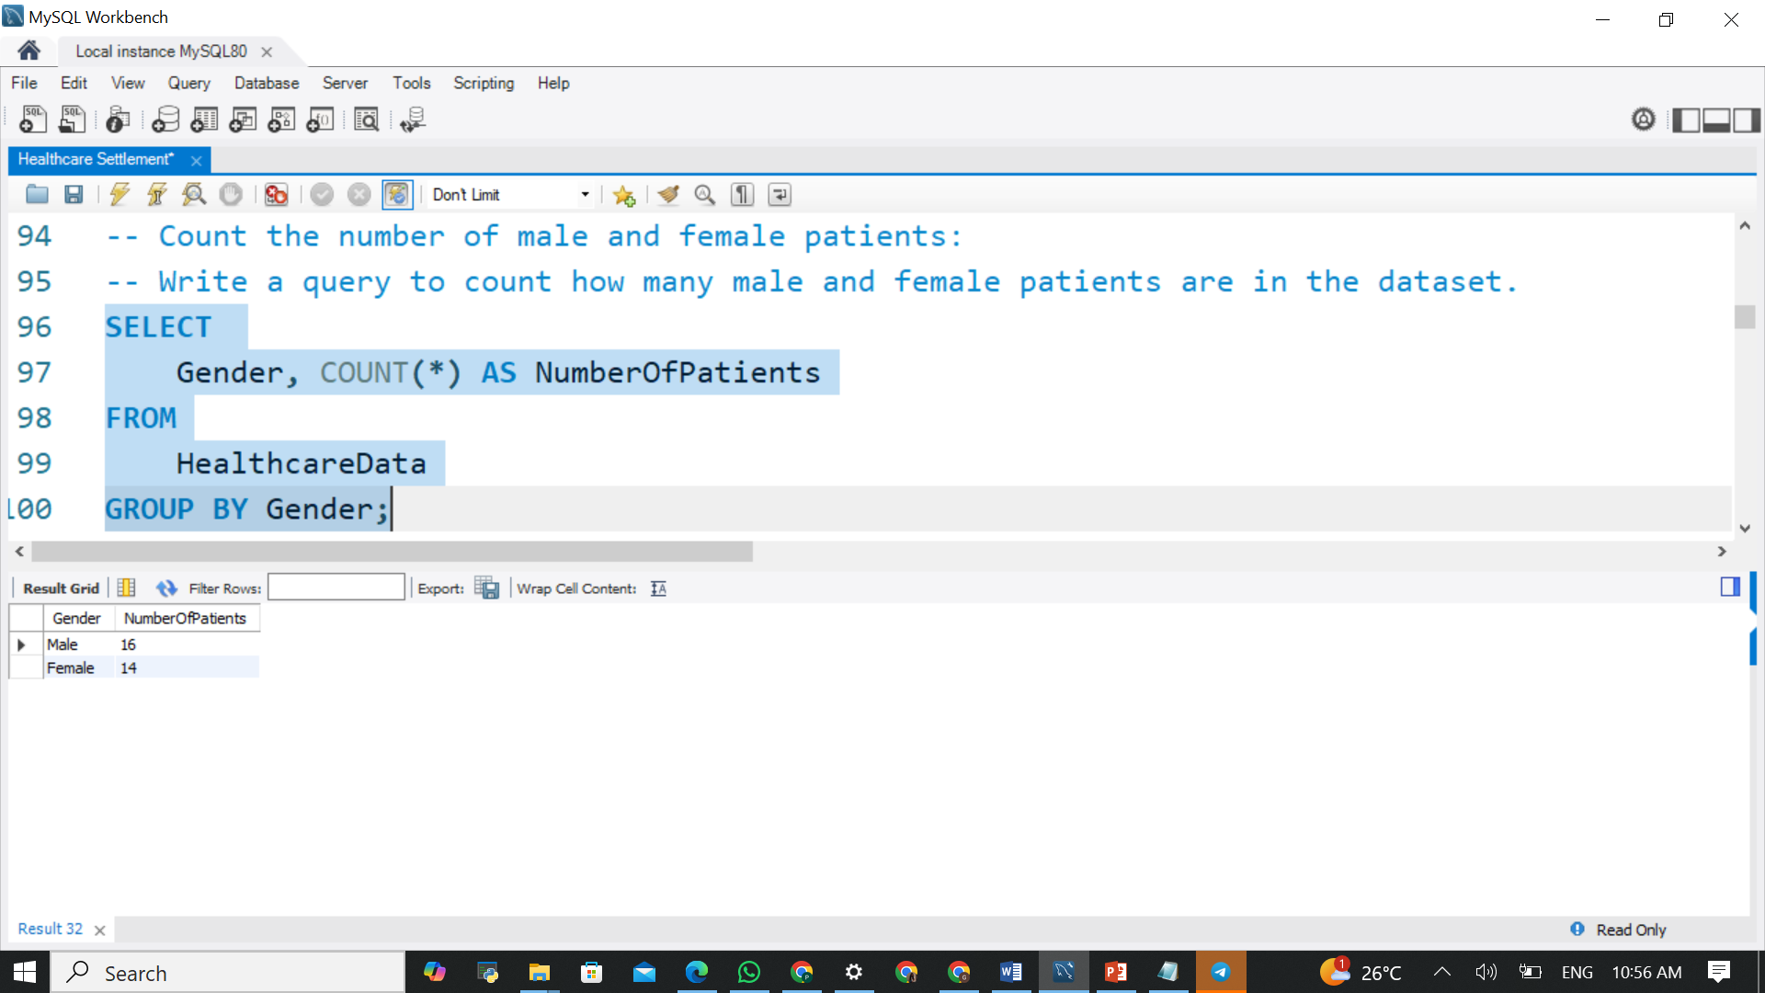
Count the number of male and female patients:

Slide 6
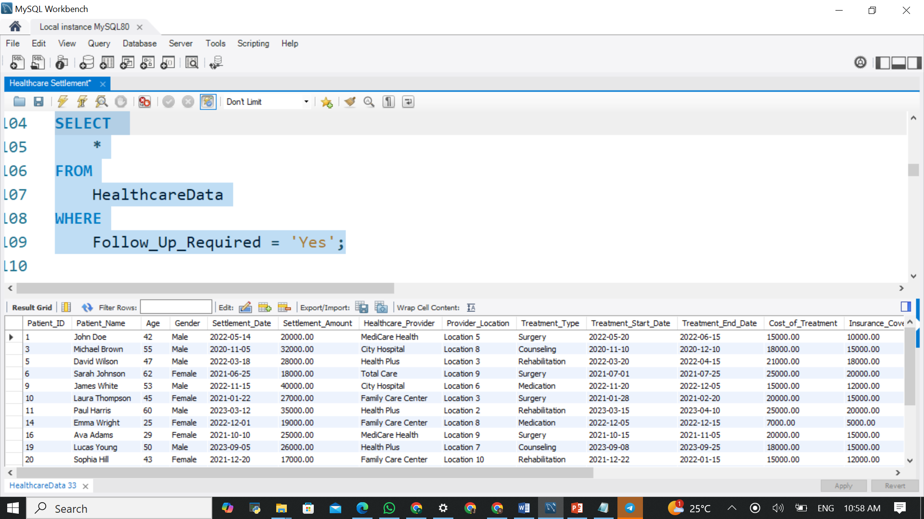
Identify patients who required follow-up:

Slide 7
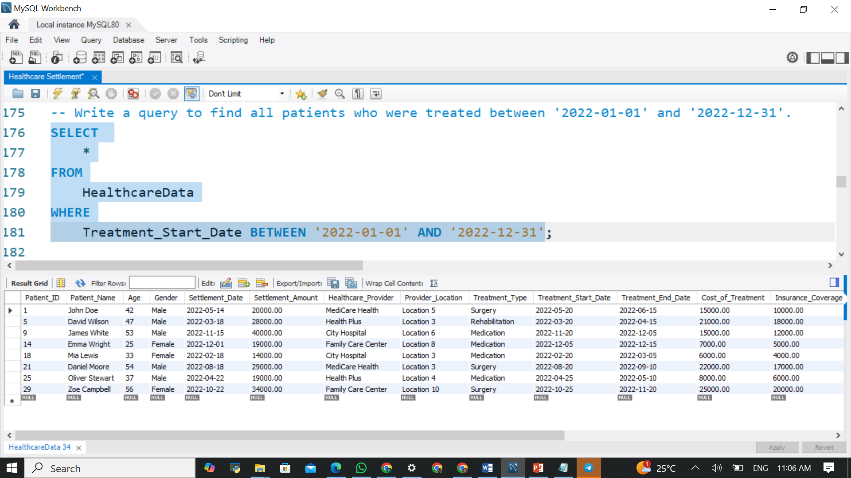
Identify patients treated within a specific date range:

Slide 8
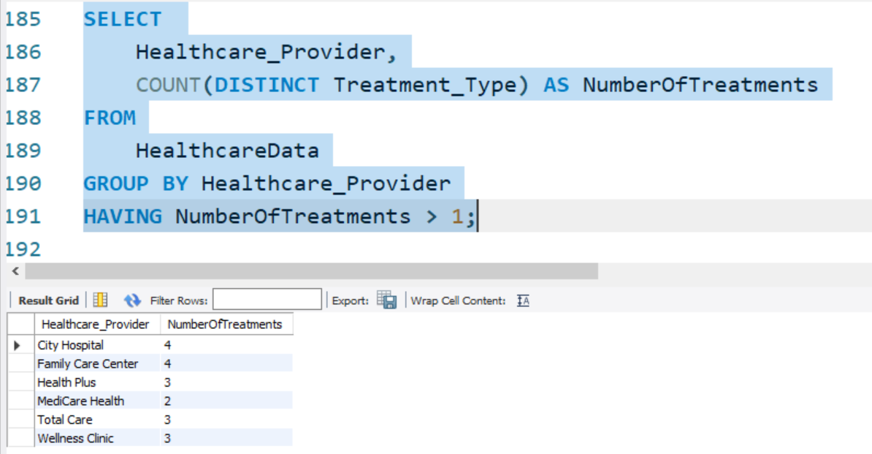
Find healthcare providers who performed more than one type of treatment:

Slide 9
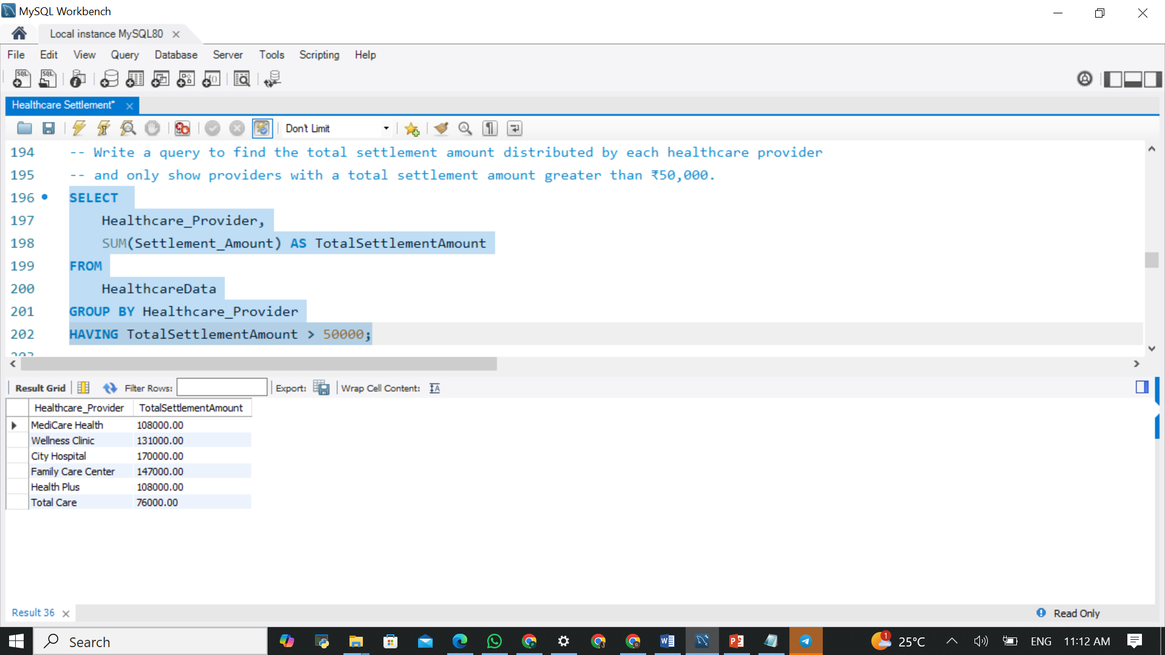
Total Settlement Amount by Healthcare Provider:

Slide 10
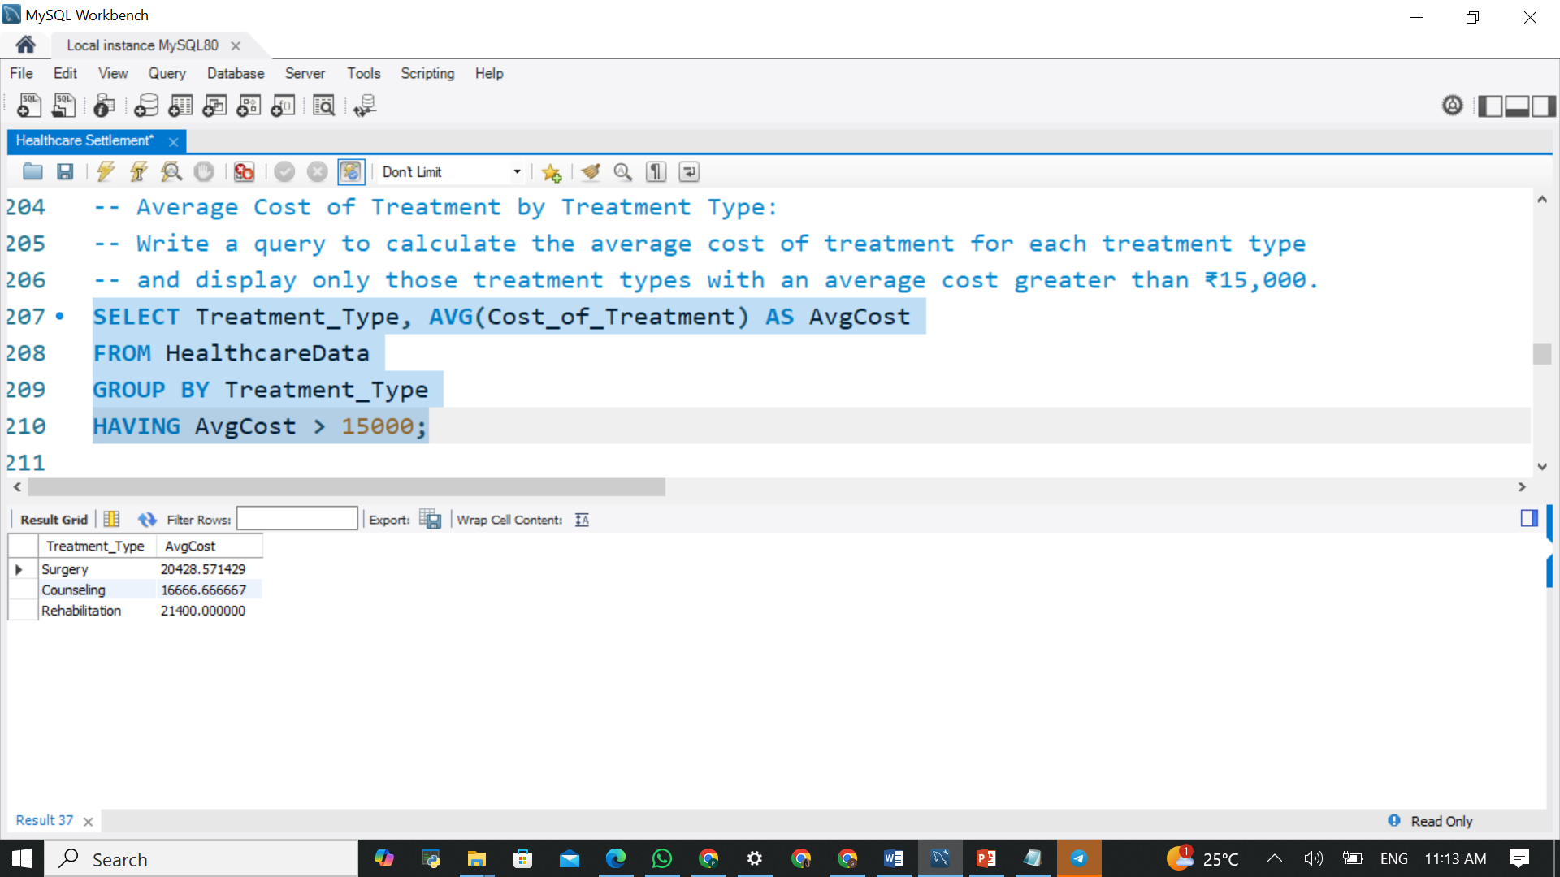
Average Cost of Treatment by Treatment Type:

Slide 11
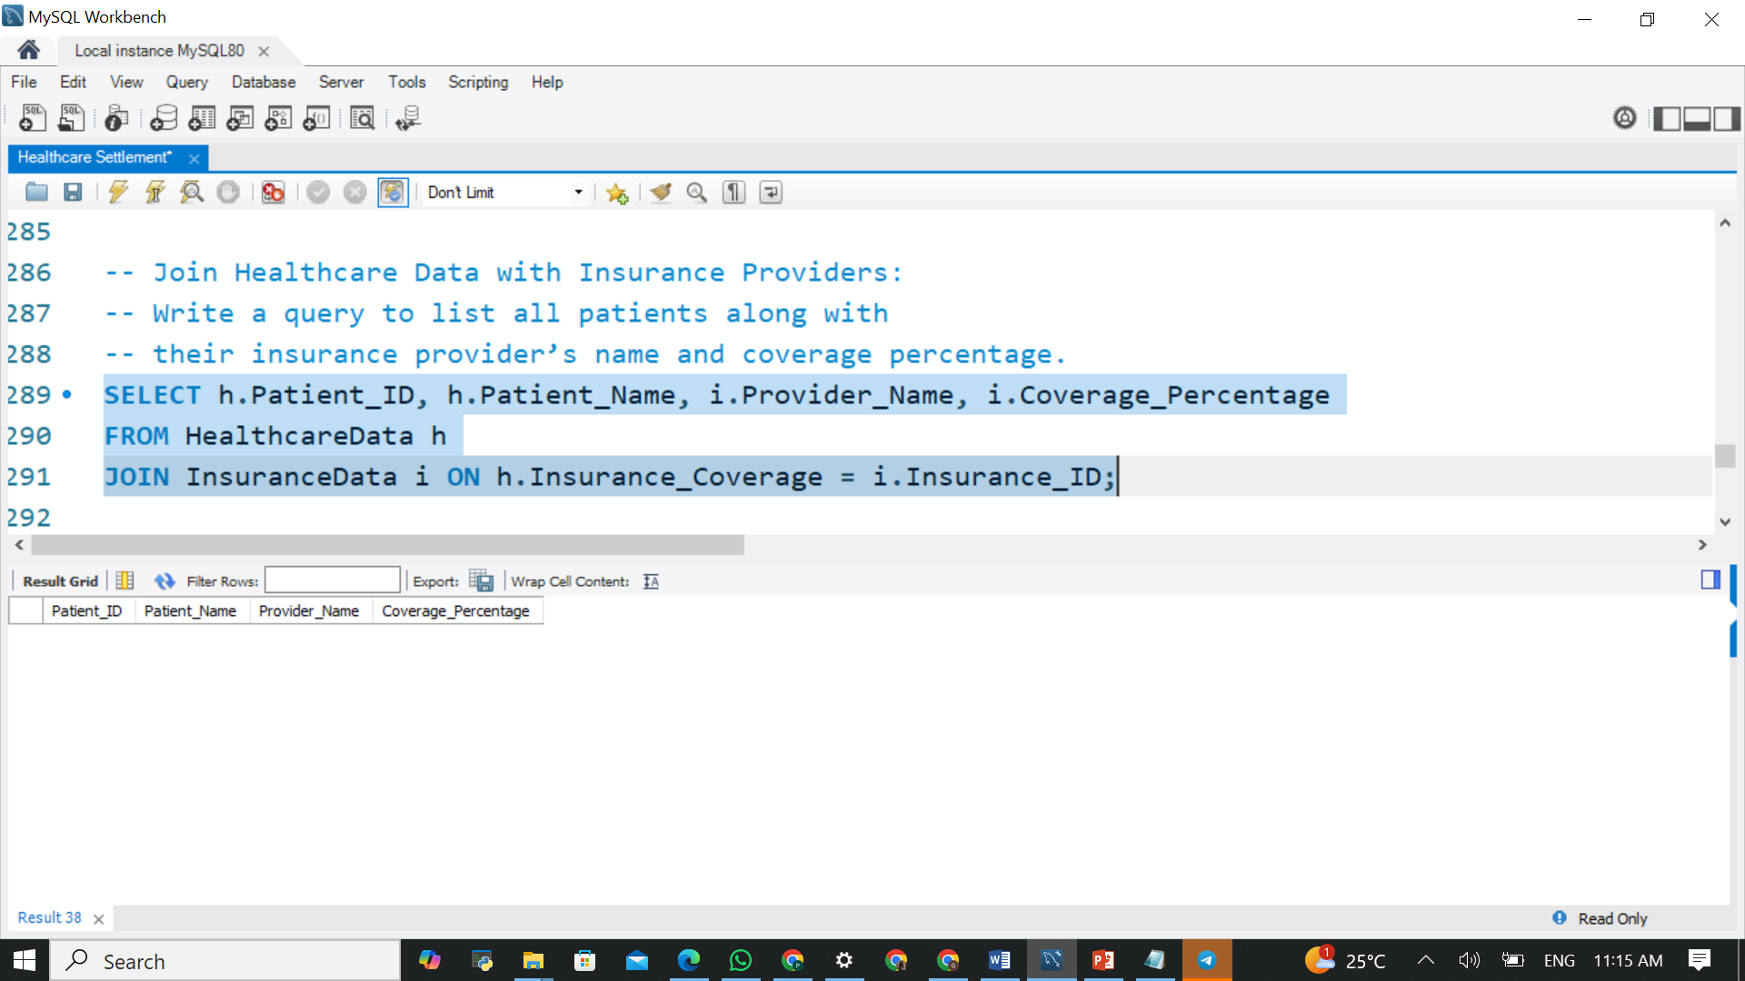
Join Healthcare Data with Insurance Providers:

Slide 12
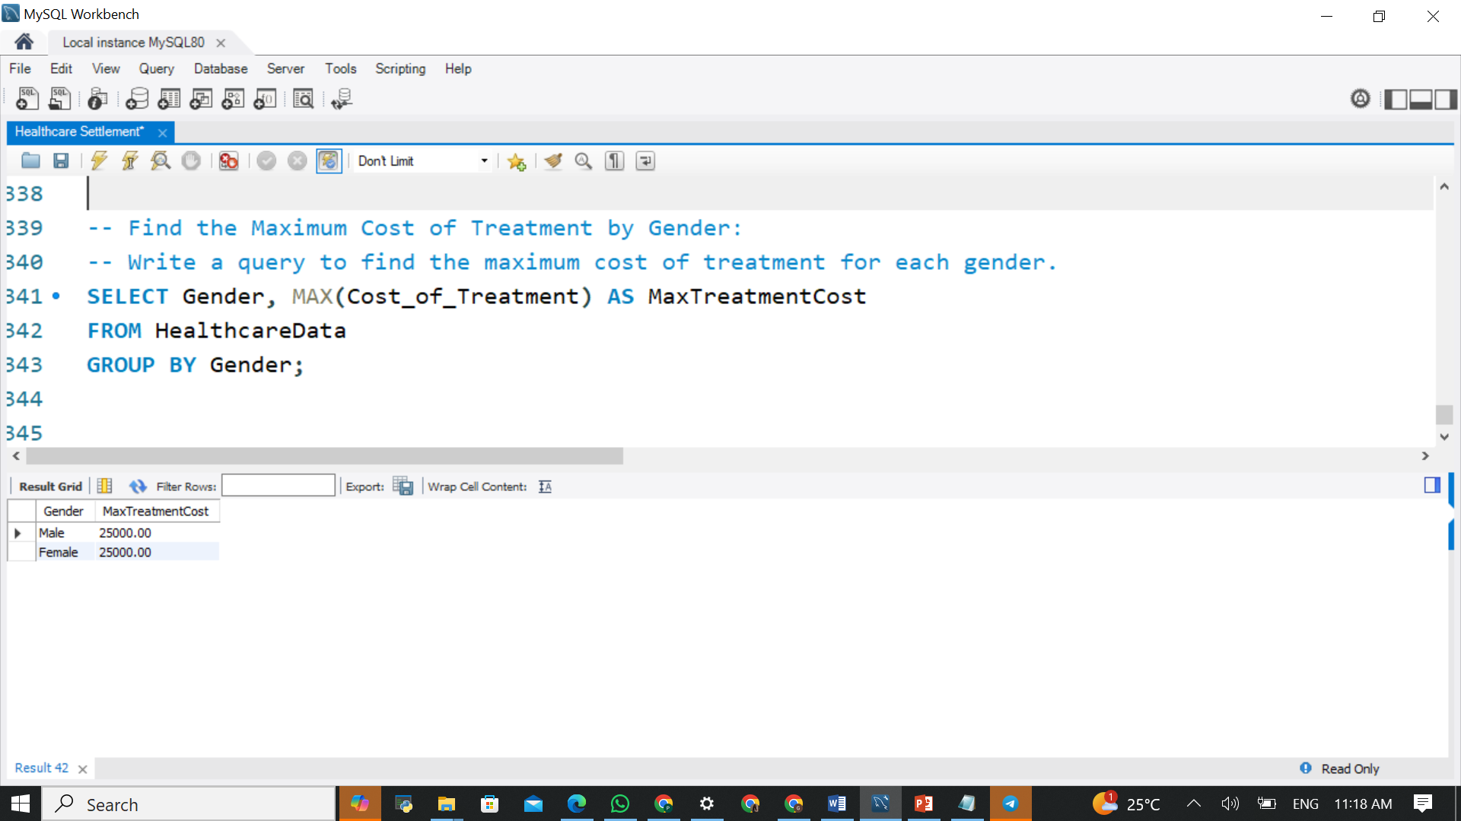
Find the Maximum Cost of Treatment by Gender:

Slide 13
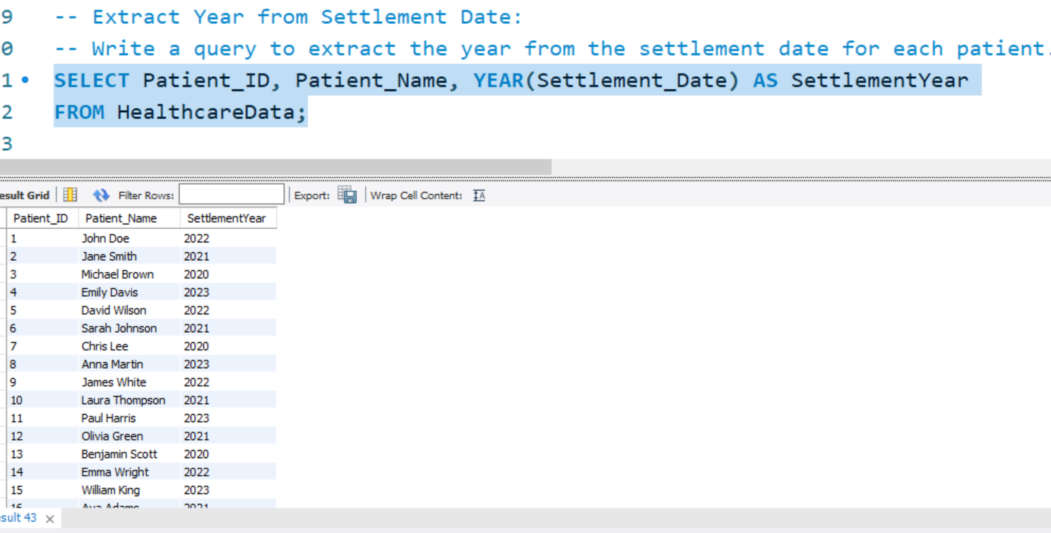
Extract Year from Settlement Date:

Slide 14

Thank You.

